Slide 1
Apriori

Slide 2
A set of items is called frequent if it satisfies a minimum threshold value for support and confidence.
Support shows transactions with items purchased together in a single transaction.
Confidence shows transactions where the items are purchased one after the other.
For frequent itemset mining method, we consider only those transactions which meet minimum threshold support and confidence requirements. Insights from these mining algorithms offer a lot of benefits, cost-cutting and improved competitive advantage.
The frequent mining algorithm is an efficient algorithm to mine the hidden patterns of itemsets within a short time and less memory consumption.

Slide 3
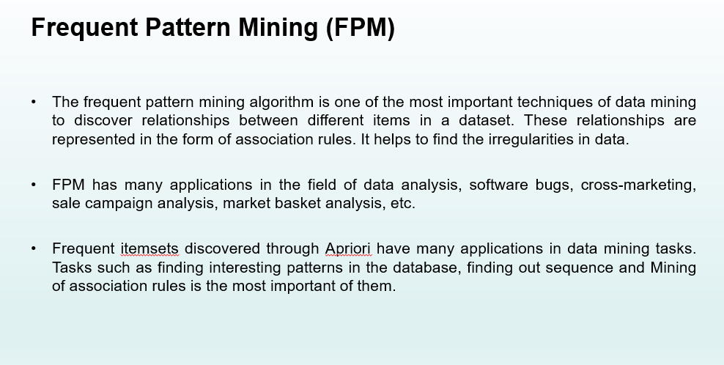

Slide 4
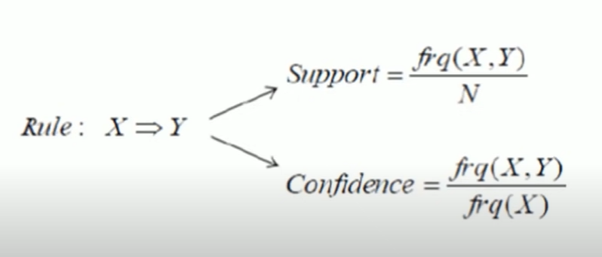

Slide 5
Support
Every association rule has a support and a confidence.
“The support is the percentage of transactions that demonstrate the rule.”
Example: Database with transactions ( customer_# : item_a1, item_a2, … )
1: 1, 3, 5.
2: 1, 8, 14, 17, 12.
3: 4, 6, 8, 12, 9, 104.
4: 2, 1, 8.
support {8,12} = 2/4(,or 50% ~ 2 of 4 customers)
support {1, 5} = 1 /4(,or 25% ~ 1 of 4 customers )
support {1} = 3/4 (,or 75% ~ 3 of 4 customers)

Slide 6
Example: Database with transactions ( customer_# : item_a1, item_a2, … )
1: 3, 5, 8.
2: 2, 6, 8.
3: 1, 4, 7, 10.
4: 3, 8, 10.
5: 2, 5, 8.
6: 1, 5, 6.
7: 4, 5, 6, 8.
8: 2, 3, 4.
9: 1, 5, 7, 8.
10: 3, 8, 9, 10.
Conf ( {5} => {8} ) ?
supp({5}) = 5/10 , supp({8}) = 7 /10 , supp({5,8}) = 4/10
then conf( {5} => {8} ) = 4/5 = 0.8 or 80%

Slide 7
Example: Database with transactions ( customer_# : item_a1, item_a2, … )
1: 3, 5, 8.
2: 2, 6, 8.
3: 1, 4, 7, 10.
4: 3, 8, 10.
5: 2, 5, 8.
6: 1, 5, 6.
7: 4, 5, 6, 8.
8: 2, 3, 4.
9: 1, 5, 7, 8.
10: 3, 8, 9, 10.
Conf ( {5} => {8} ) ? 80% Done. Conf ( {8} => {5} ) ?
supp({5}) = 5/10 , supp({8}) = 7/10 , supp({5,8}) = 4/10
then conf( {8} => {5} ) = 4/7 = 0.57 or 57%

Slide 8
Conf ( {5} => {8} ) ? 80% Done.
Conf ( {8} => {5} ) ? 57% Done.
Rule ( {5} => {8} ) more meaningful than
Rule ( {8} => {5} )

Slide 9
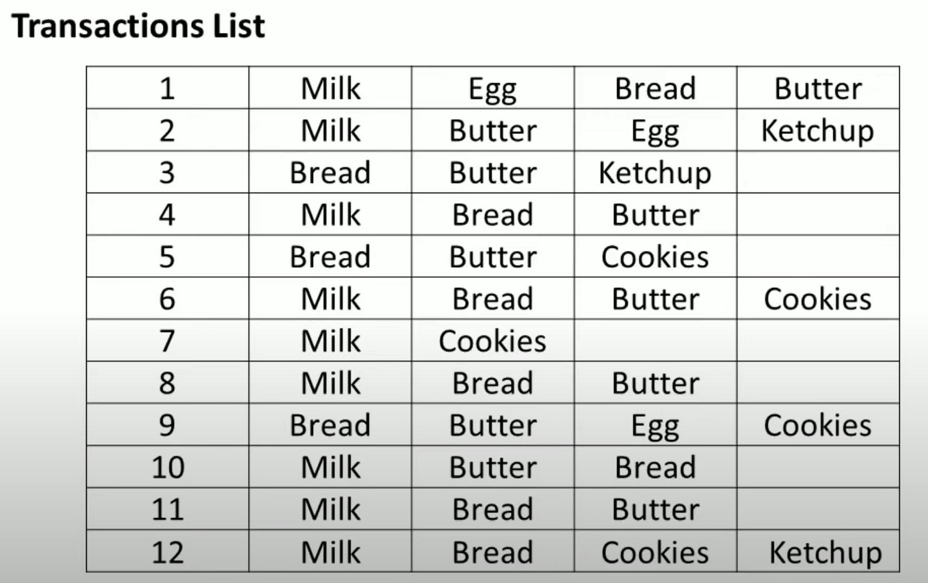

Slide 10
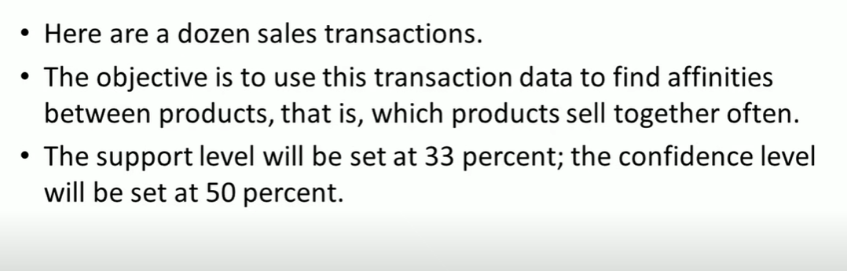


Slide 11
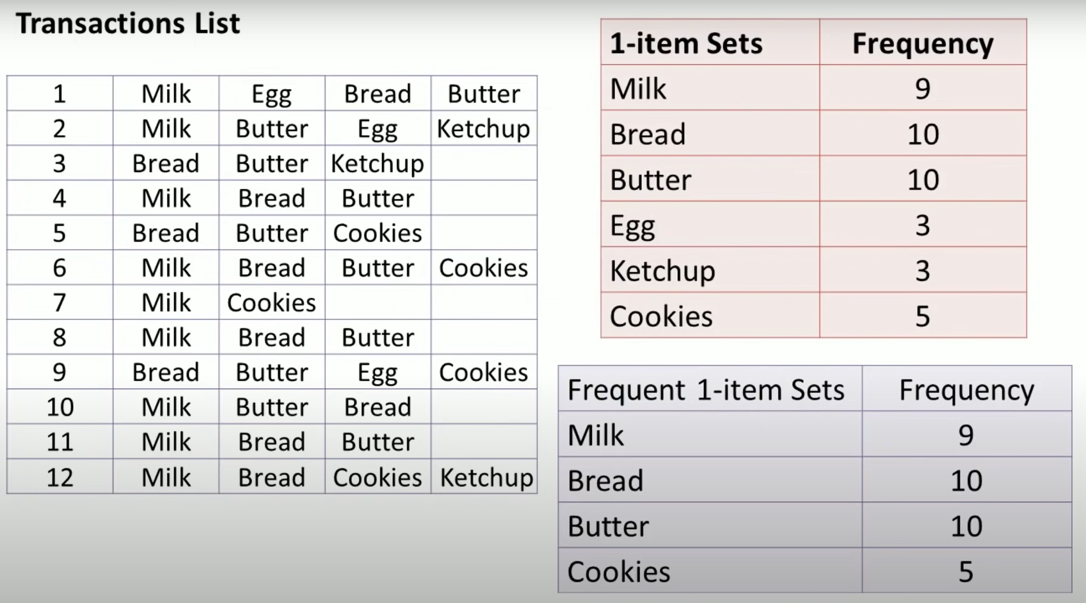

Slide 12
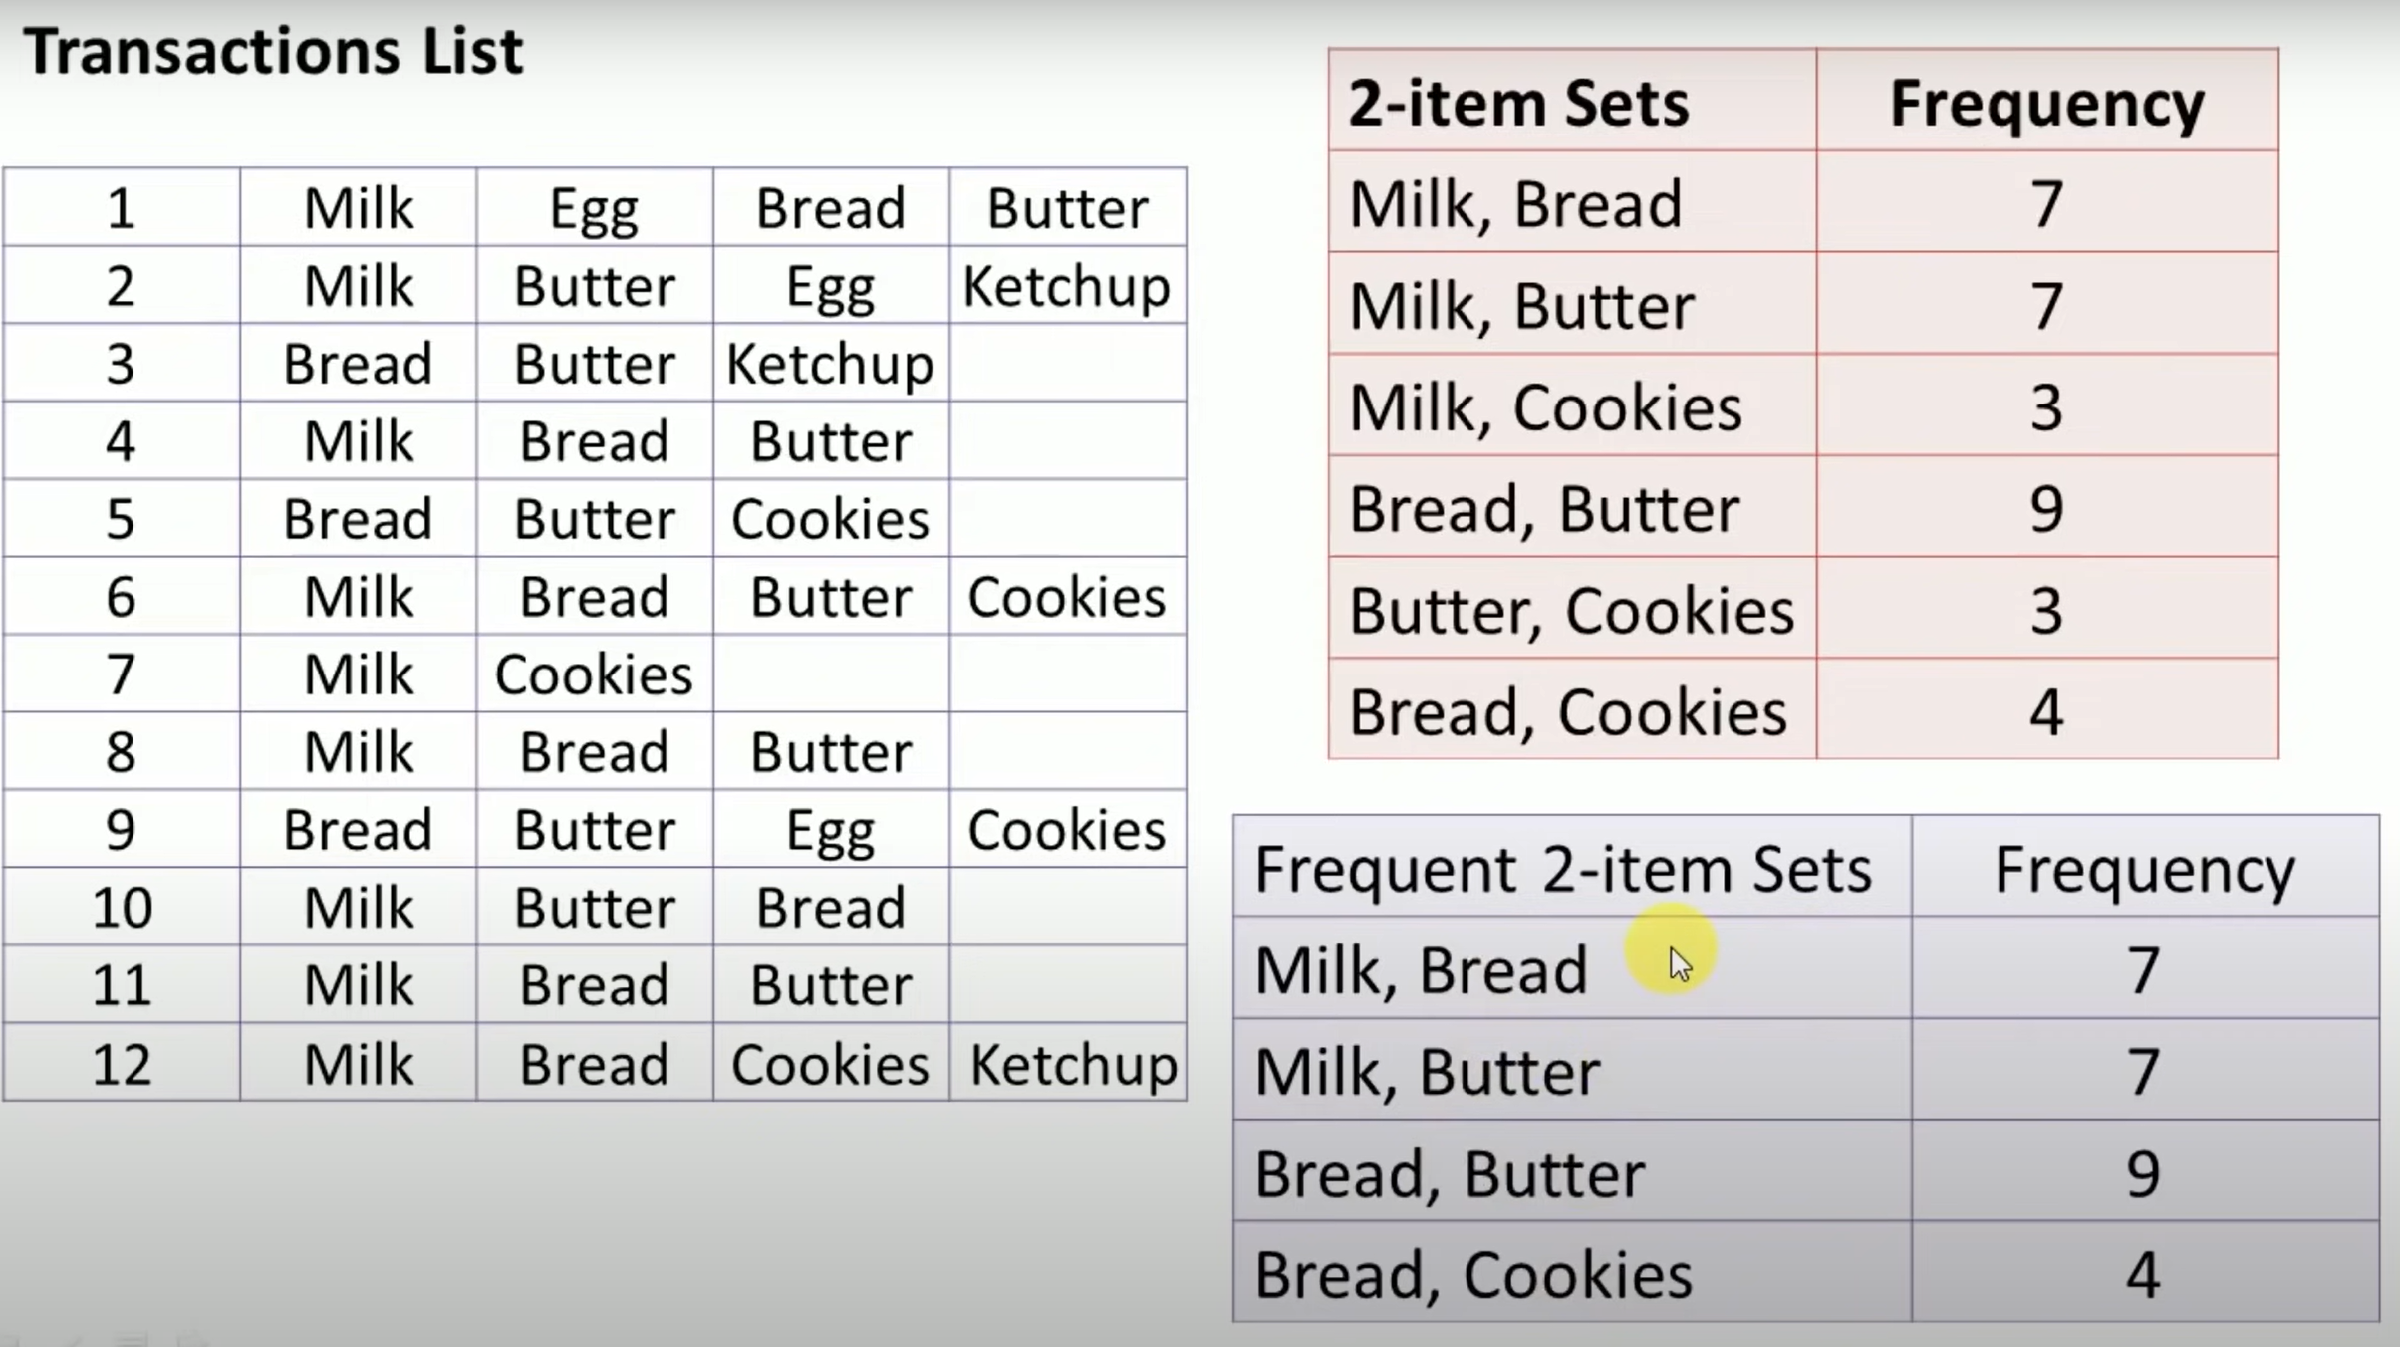

Slide 13
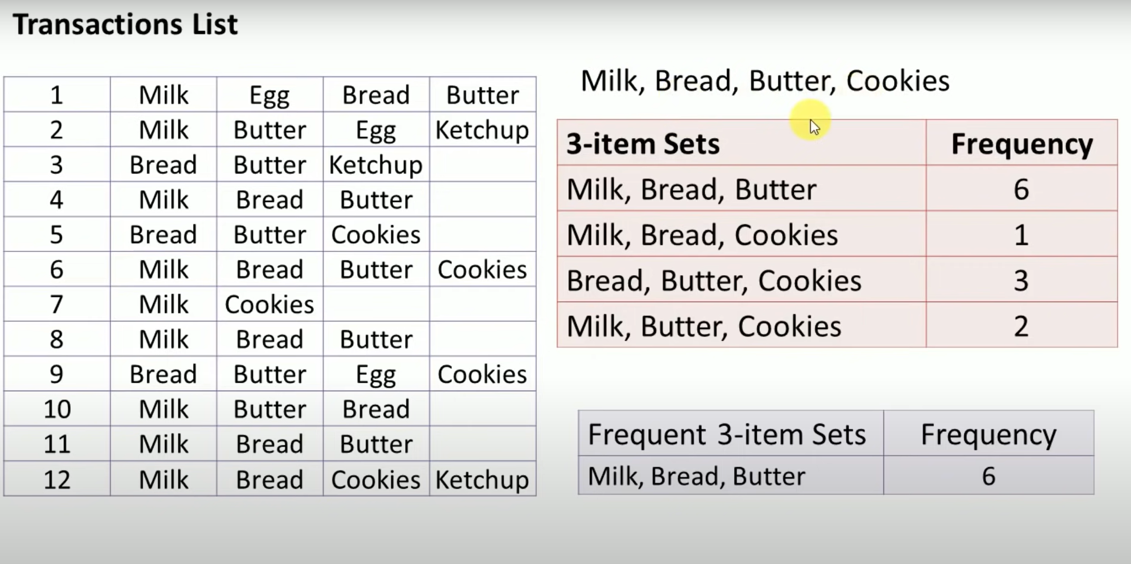

Slide 14
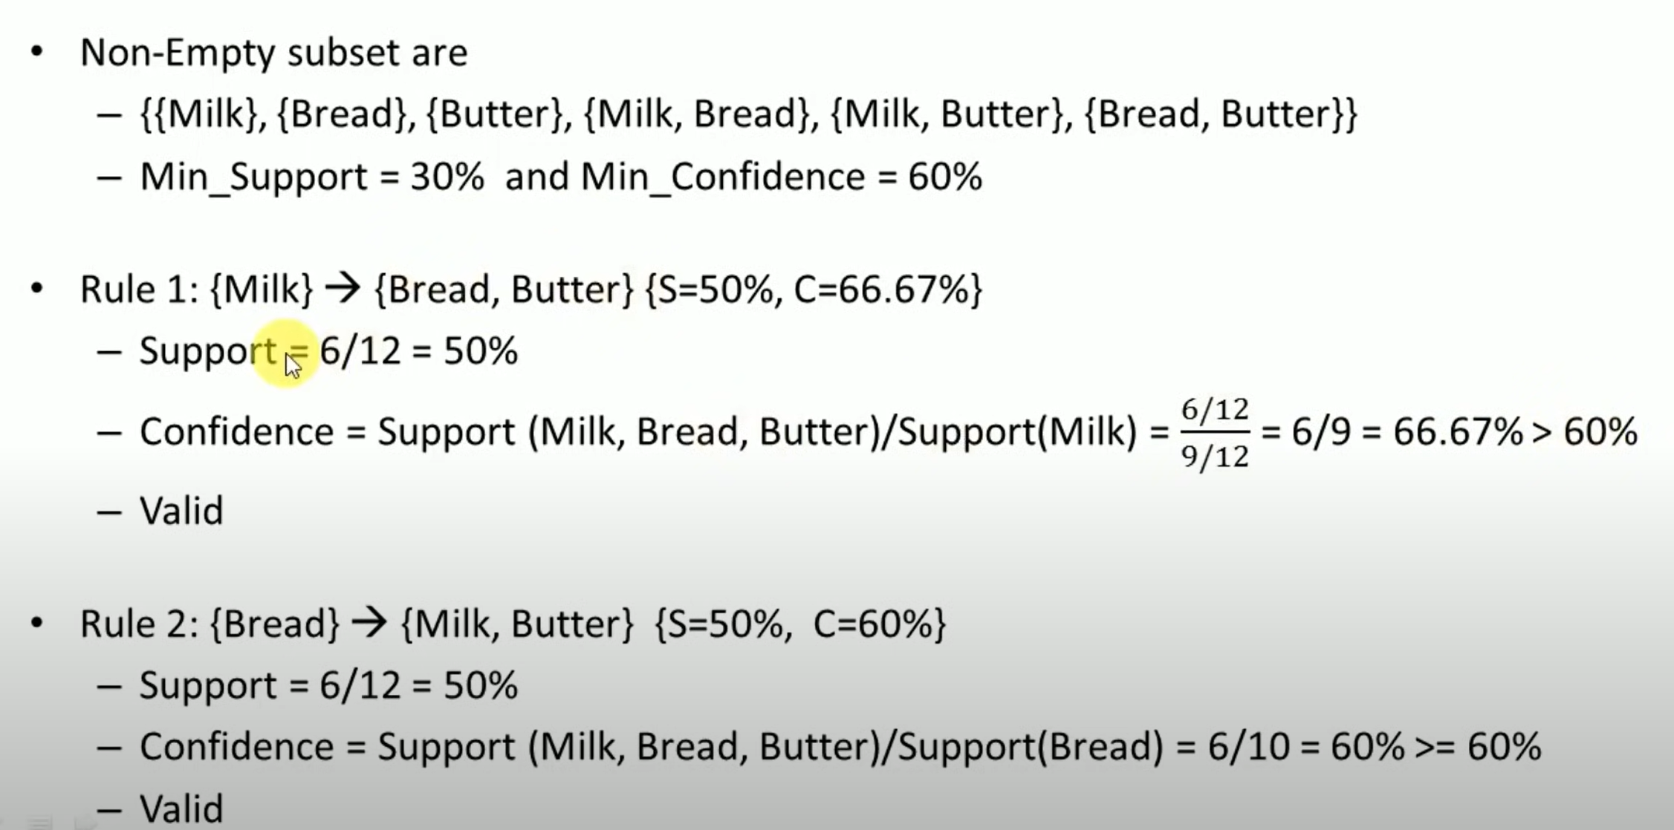
Association rules

Slide 15
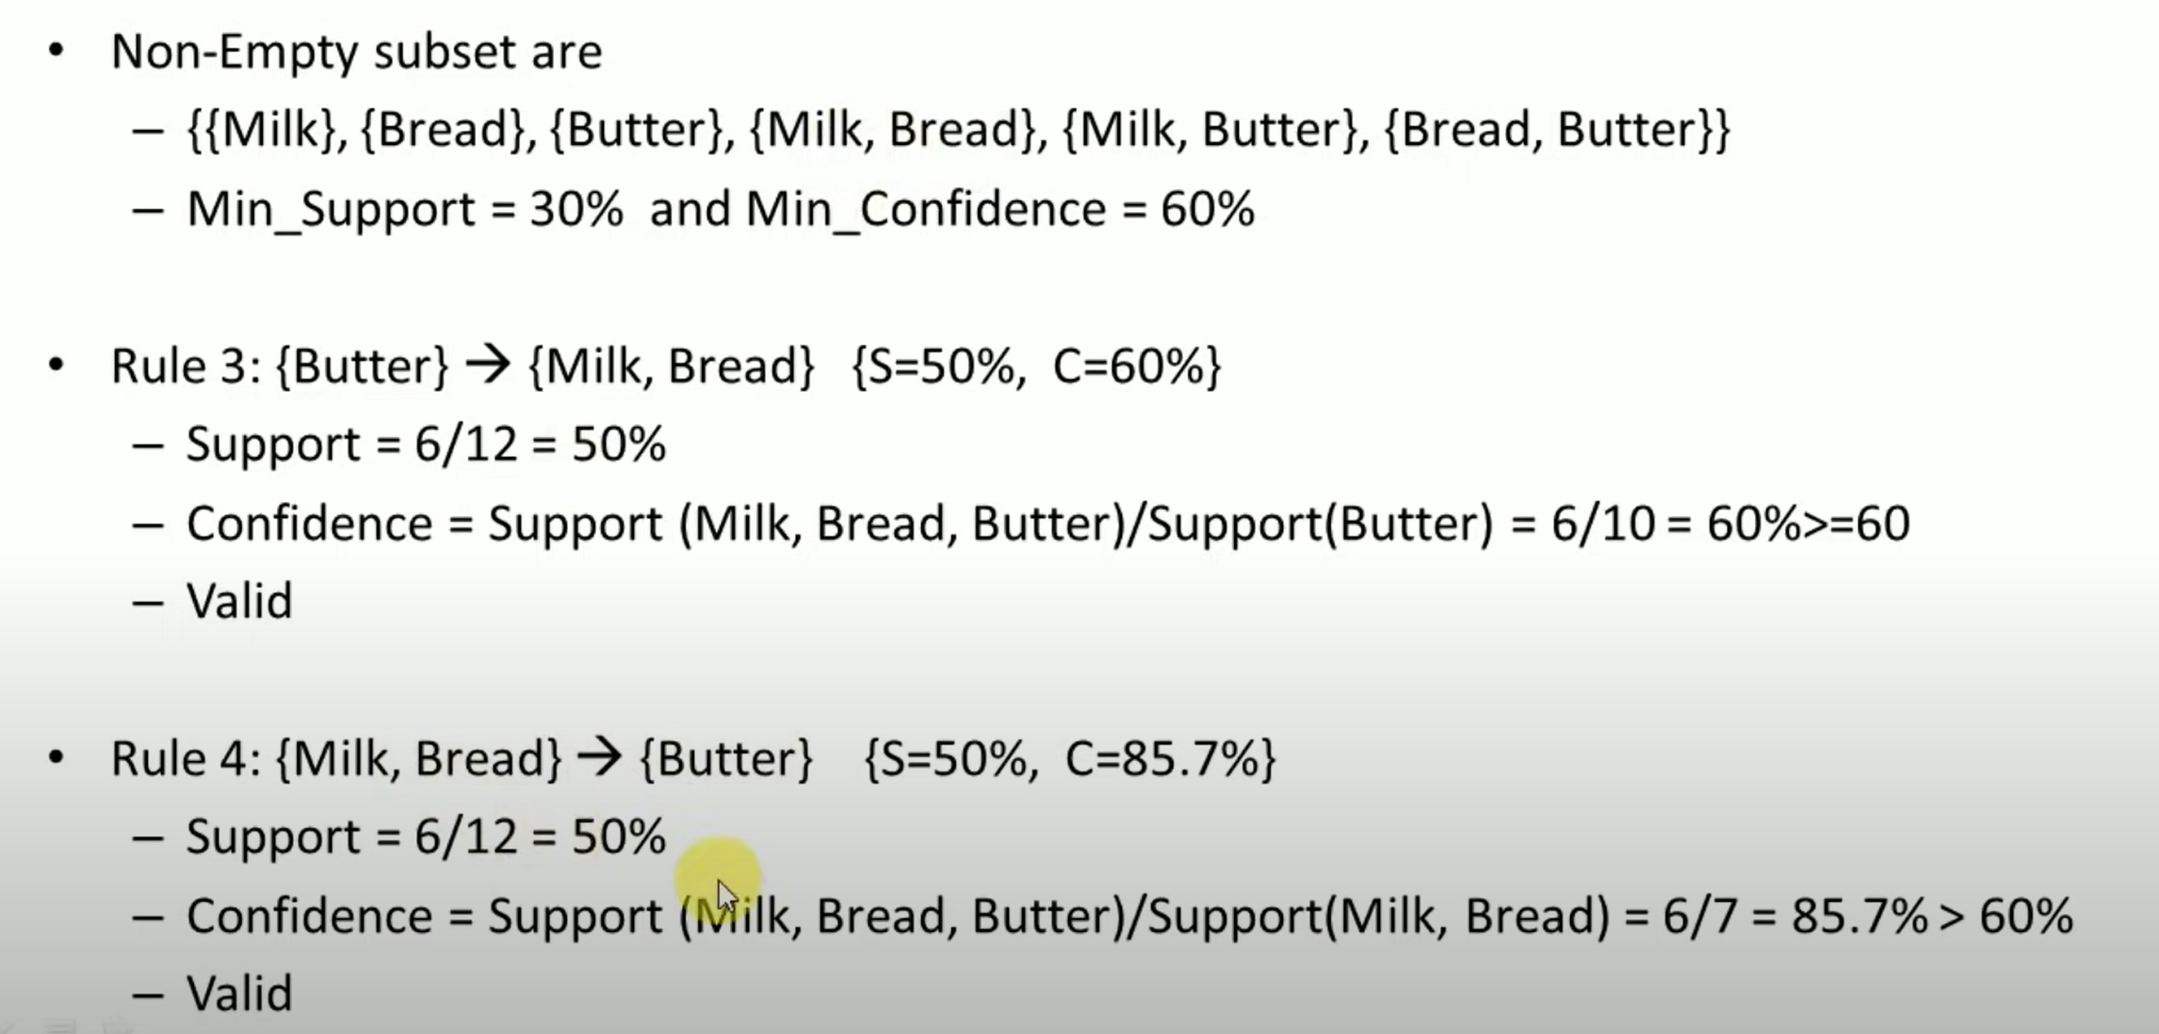

Slide 16
